Slide 1

Employee Data Analysis using Excel
STUDENT NAME: R.BHARATH KUMAR REGISTER NO: 312200218
DEPARTMENT: B.COM ACCOUNTS AND FINANCE
NAAN MUDHALVAN ID :
Asunm103unm103312200218
COLLEGE : S.I.V.E.T. COLLEGE
1

Slide 2
PROJECT TITLE
Employee Salary
Analysis using Excel
2

Slide 3




AGENDA
1.Problem Statement 2.Project Overview 3.End Users
4.Our Solution and Proposition 5.Dataset Description
6.Modelling Approach 7.Results and Discussion
8.Conclusion
3
3/21/2024 Annual Review

Slide 4

PROBLEM STATEMENT
The current performance evaluation system relies heavily on subjective assessments and limited data, leading to inconsistencies and inefficiencies. There is a need to develop a more structured, data-driven approach to evaluate employee performance using quantitative metrics.
4

Slide 5

PROJECT OVERVIEW
This project aims to use Excel for a comprehensive analysis of employee performance within an organization.
By leveraging Excel's data manipulation and analytical capabilities, we will evaluate employee performance against key performance indicators (KPIs), identify trends, and
generate insights to support management decisions.
To analyze employee performance using the available dataset in Excel, and to provide actionable insights that support fair and objective performance evaluations.
5

Slide 6
The project involves creating an Excel-based performance analysis system to assess and enhance employee effectiveness. Using Excel, we will collect and analyze performance data, identify patterns, and generate reports that highlight both individual and team performance.
The goal is to provide actionable insights that can lead to better
decision-making, targeted training, and improved organizational outcomes.

Slide 7

WHO ARE THE END USERS?
TEAM LEADER
ORGANISERS
HR MANAGER
EMPLOYERS
7

Slide 8

OUR SOLUTION AND ITS VALUE PROPOSITION
Filtering in Excel allows you to selectively display and analyze specific subsets of data based on criteria, enabling focused insights and streamlined data management.
Groups in Excel help organize and manage data by allowing users to collapse or expand sections of related rows or columns, facilitating better data navigation and analysis.
A Pivot Table in Excel is a powerful tool that summarizes, analyzes, and presents large datasets by organizing data into rows, columns, and values for dynamic and interactive reporting.
8

Slide 9
Dataset Description
There is 5 features in employee dataset.
Business unit : "Business Unit," "Revenue," "Expenses," "Profit," and "Market Share" to clearly present and compare metrics for each unit.
Performance score : Conditional Formatting Apply conditional formatting to highlight high or low performance scores for better visualization.
Current employee rating : Number Format Ensure that the Rating column is formatted to show numbers or a rating scale if applicable.
performance level gender :Create a summary table to analyze performance levels by gender. This table will help you visualize the data more effectively.

Slide 10

THE "WOW" IN OUR SOLUTION
Performance level
IFS (Z8-5”VERY HIGH”28- 4,”HIGH”,28>3,”MED”,TRUE,”LOW”)
3/21/2024 Annual Review
10

Slide 11
MODELLING
Use PivotTables for Advanced Analysis
PivotTables can dynamically summarize and analyze your data:
Select Your Data Range. Go to Insert > PivotTable. Configure PivotTable:
Rows: Employee Name or Department.
Columns: Performance Metrics.
Values: Average or Count of Performance Metrics.
Incorporate Conditional Formatting
Highlight key performance metrics:
Select Cells: Highlight the range of performance data.
Conditional Formatting: Go to Home > Conditional Formatting > Color Scales or Data Bars to apply formatting based on performance values.
11

Slide 12
Performance by Project
Select Data: Highlight the summary table by project.
Insert Chart: Go to Insert > Column or Bar Chart to create a visual comparison of metrics across projects.
Conditional Formatting: Apply conditional formatting to highlight key performance metrics and trends, making it easier to spot areas that need attention.
Interactive Elements: Incorporate slicers and other interactive elements to make your analysis more dynamic and user-friendly. This enables viewers to filter data based on different criteria and get customized insights.
Dashboard Creation: Compile your data, summaries, and visualizations into a cohesive dashboard. This dashboard should provide a comprehensive view of employee performance, helping stakeholders make informed decisions.
PivotTables: Leverage PivotTables for dynamic analysis, allowing you to easily slice and dice the data to reveal deeper insights and trends.

Slide 13
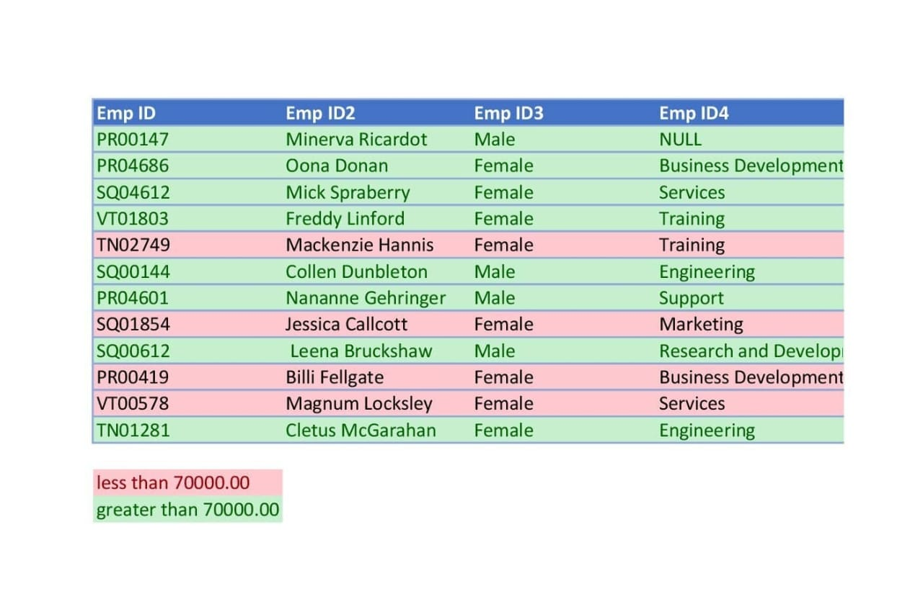
RESULTS
13

Slide 14
conclusion
In summary, creating an effective employee performance analysis model in Excel involves several key steps to ensure you can track, analyze, and visualize data efficiently:
Data Organization: Start by structuring your data in a well-organized table, including essential fields such as Employee ID, Name, Gender, Department, Project ID, Performance Metrics, and Ratings.
Summary Tables: Develop summary tables to aggregate data by projects and departments. This helps in understanding overall performance trends and making comparisons.
Visualization: Utilize charts and graphs to visually represent performance data. Bar charts, pie charts, and line graphs can provide clear insights into how employees are performing across different projects and departments.

Slide 15
Conditional Formatting: Apply conditional formatting to highlight key performance metrics and trends, making it easier to spot areas that need attention.
Interactive Elements: Incorporate slicers and other interactive elements to make your analysis more dynamic and user-friendly. This enables viewers to filter data based on different criteria and get customized insights.
Dashboard Creation: Compile your data, summaries, and visualizations into a cohesive dashboard. This dashboard should provide a comprehensive view of employee performance, helping stakeholders make informed decisions.
PivotTables: Leverage PivotTables for dynamic analysis, allowing you to easily slice and dice the data to reveal deeper insights and trends.

